Slide 1
Battleship
Katelynn Call & Cheston Gray

Slide 2
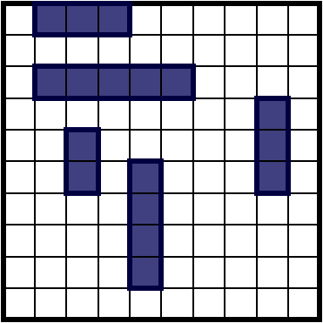
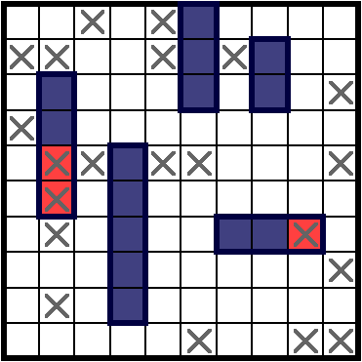
Quick Review and Rules For battleship
5 ships placed on a 10x10 grid
Carrier – length of 5
Battleship – length of 4
Submarine – length of 3
Destroyer – length of 3
Patrol Boar – length of 2
Players take turn “shooting” at the other players ship by calling out coordinates (a1), (b5), (j10), ect:
Object of the game is to sink the opponent's fleet.
If a hit sinks a ship it must be announced.
Because the grid is 10x10 there are 100 possible locations for a player to shoot.
Example of a game board
Example of a game in progress

Slide 3
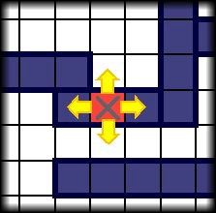
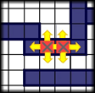
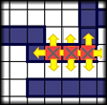
Basic Strategies and their statistics
Picking coordinates completely at random:
90% chance you’ll need more than 98 shots
50% chance you’ll need more than 96 shots
25% chance you’ll need more than 93 shots
10% chance you’ll need less than 89 shots
1% chance you’ll need less than 75 shots
Random Selection then “Hunting” down a hit
You select random coordinates until you score a hit, then systematically check the surrounding area.
90% chance you’ll need more than 83 shots
50% chance you’ll need more than 65 shots
10% chance you’ll need less than 50 shots
1% chance you’ll need less than 39 shots
“Hunting” strategy

Slide 4
A more Effective Solution:
Calculating the odds by using superposition of all possible locations for surviving ships.
Each square needs to add up how times it could be used as a legal move for:
Each of the remaining ships
Each segment of length for every remaining ship
Both vertically and horizontally
These calculations are going to be done in parallel.

Slide 5
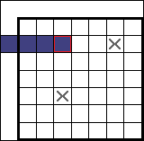
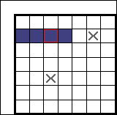
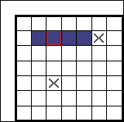
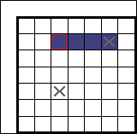
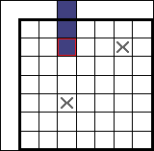
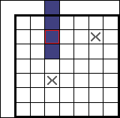
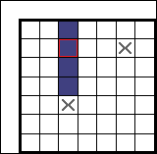
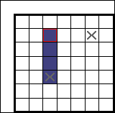
Superposition Calculation Example
There are 3 possible ways to arrange this 4-length ship.
We need to repeat this process for every square, and every remaining ship
Invalid: Out of Bounds
Valid
Valid
Invalid: Has already been hit
Invalid: Out of Bounds
Invalid: Out of Bounds
Valid
Invalid: Has already been hit

Slide 6

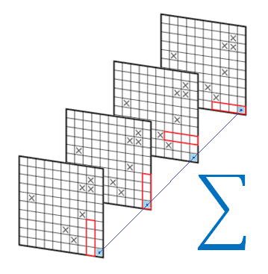
Statistics for Using Superposition:
Picking coordinates completely at random:
90% chance you’ll need less than 56 shots
50% chance you’ll need less than 43 shots
25% chance you’ll need less than 36 shots
10% chance you’ll need less than 32 shots
1% chance you’ll need less than 25 shots

